Slide 1
Environmental Impacts of Minerals 2

Slide 2
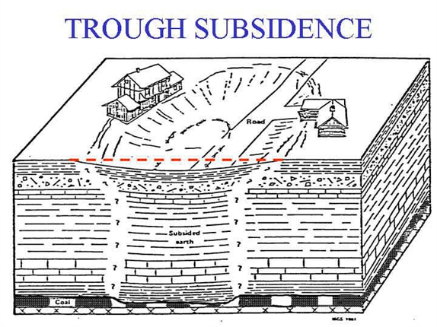
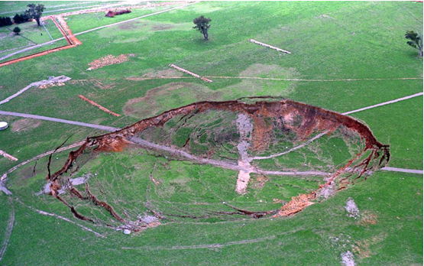
Land Subsidence
Mine subsidence is the settling of the ground surface following the extraction of an underground ore body.
damage buildings, infrastructure, and utilities (pipelines, etc.)
Subsidence above underground mine in Australia.

Slide 3
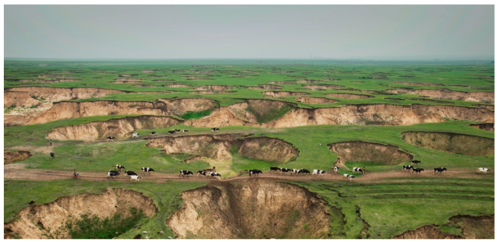
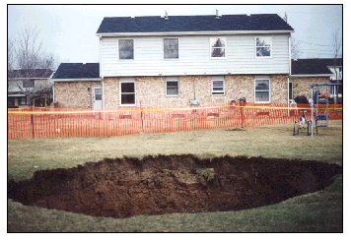
Land subsidence from Mines

Slide 4
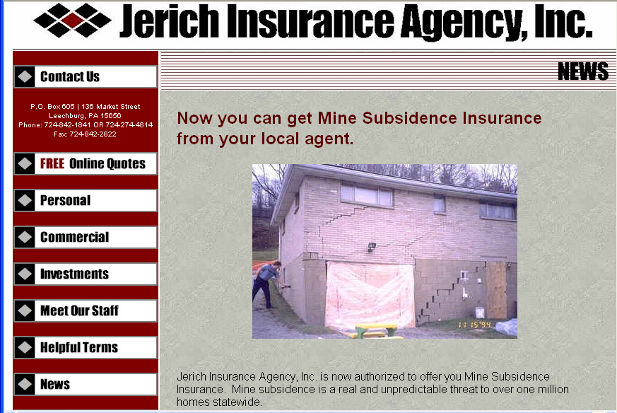
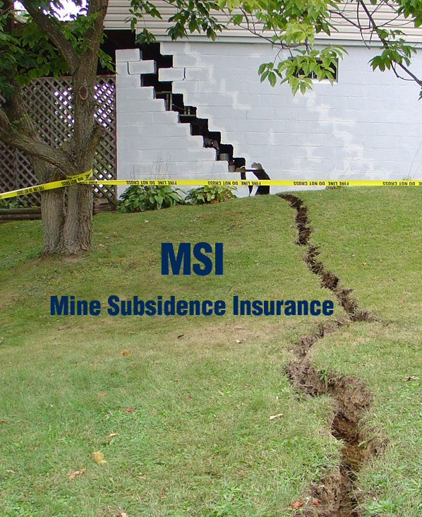
If you move to Pennsylvania,

Slide 5
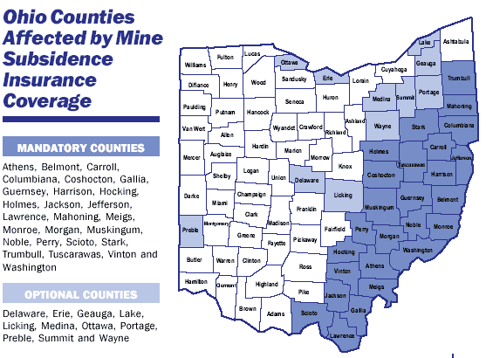
Or Ohio….

Slide 6
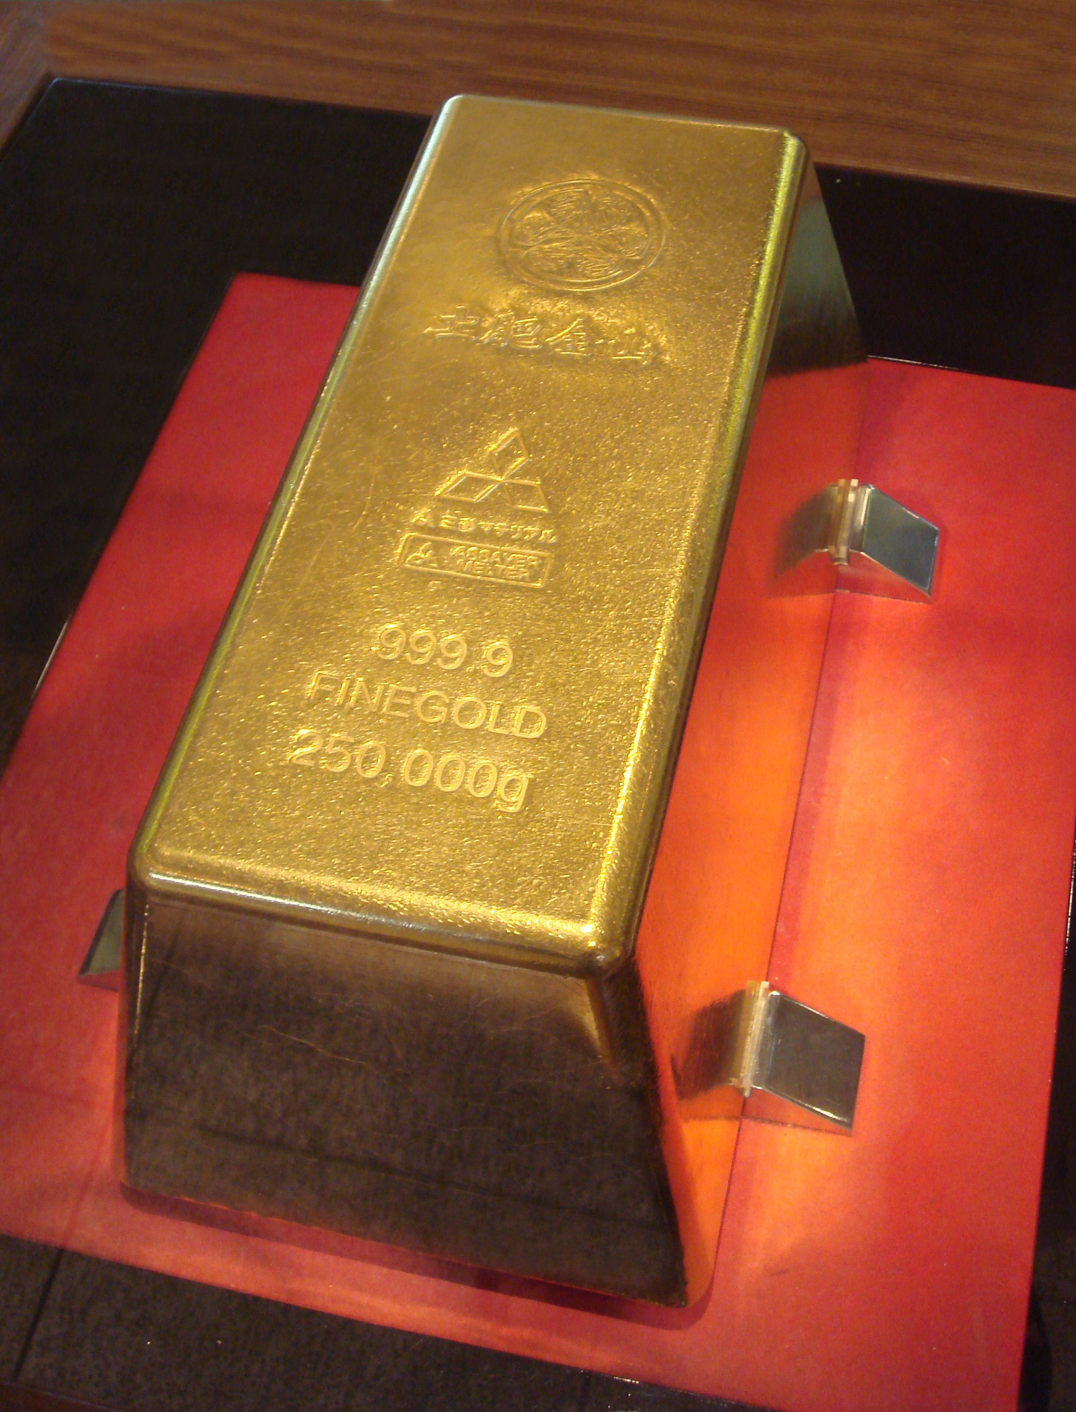
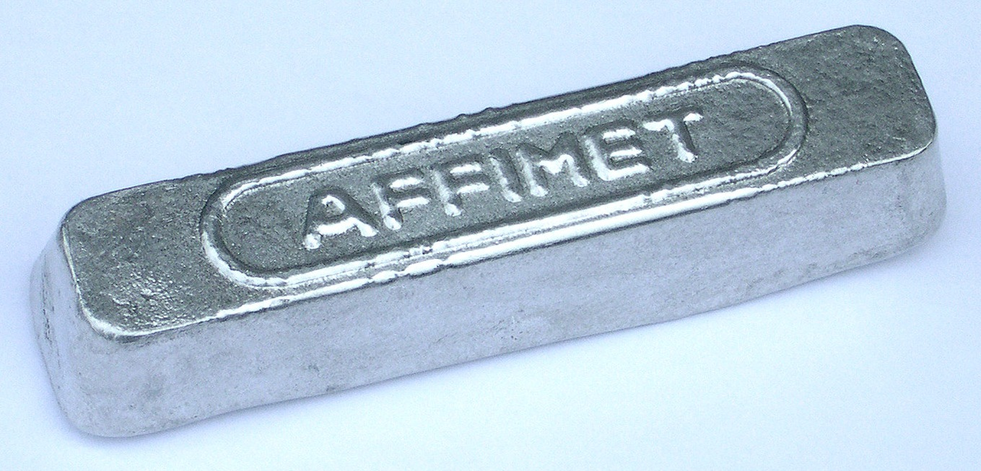
Beneficiation
So, after you extract the ore, it still doesn’t look anything like this:
Beneficiation is the process through which the desired minerals are concentrated.
The processes used varies depending on:
the mineral desired
what form it is in the rock
composition of the host rock
We will discuss a few of the most common beneficiation processes…
Aluminum ingot
Gold ingot from Toi Mine
Notes:
Image Information Slide 19 Beneficiation:
Gold Ingot: Credit: PGHCOM (2007) “A 250kg gold car in the Toi gold mine.” Downloaded from: http://upload.wikimedia.org/wikipedia/commons/4/43/Toi_250kg_gold_bar.jpg under a Creative Commons Attribution-Share Alike 3.0 Unported license (http://creativecommons.org/licenses/by-sa/3.0/deed.en) and GNU Free Documentation License (http://en.wikipedia.org/wiki/GNU_Free_Documentation_License); http://commons.wikimedia.org/wiki/File:Toi_250kg_gold_bar.jpg.
Aluminum Ingot: Credit: Romary (2006) “Aluminum ingot.” Downloaded from: http://upload.wikimedia.org/wikipedia/commons/d/d7/Lingot_aluminium.jpg under a Creative Commons Attribution-Share Alike 3.0 Unported license (http://creativecommons.org/licenses/by-sa/3.0/deed.en) and GNU Free Documentation License (http://en.wikipedia.org/wiki/GNU_Free_Documentation_License) and Creative Commons Attribution 2.5 Generic license (http://creativecommons.org/licenses/by/2.5/deed.en); http://commons.wikimedia.org/wiki/File:Lingot_aluminium.jpg.

Slide 7
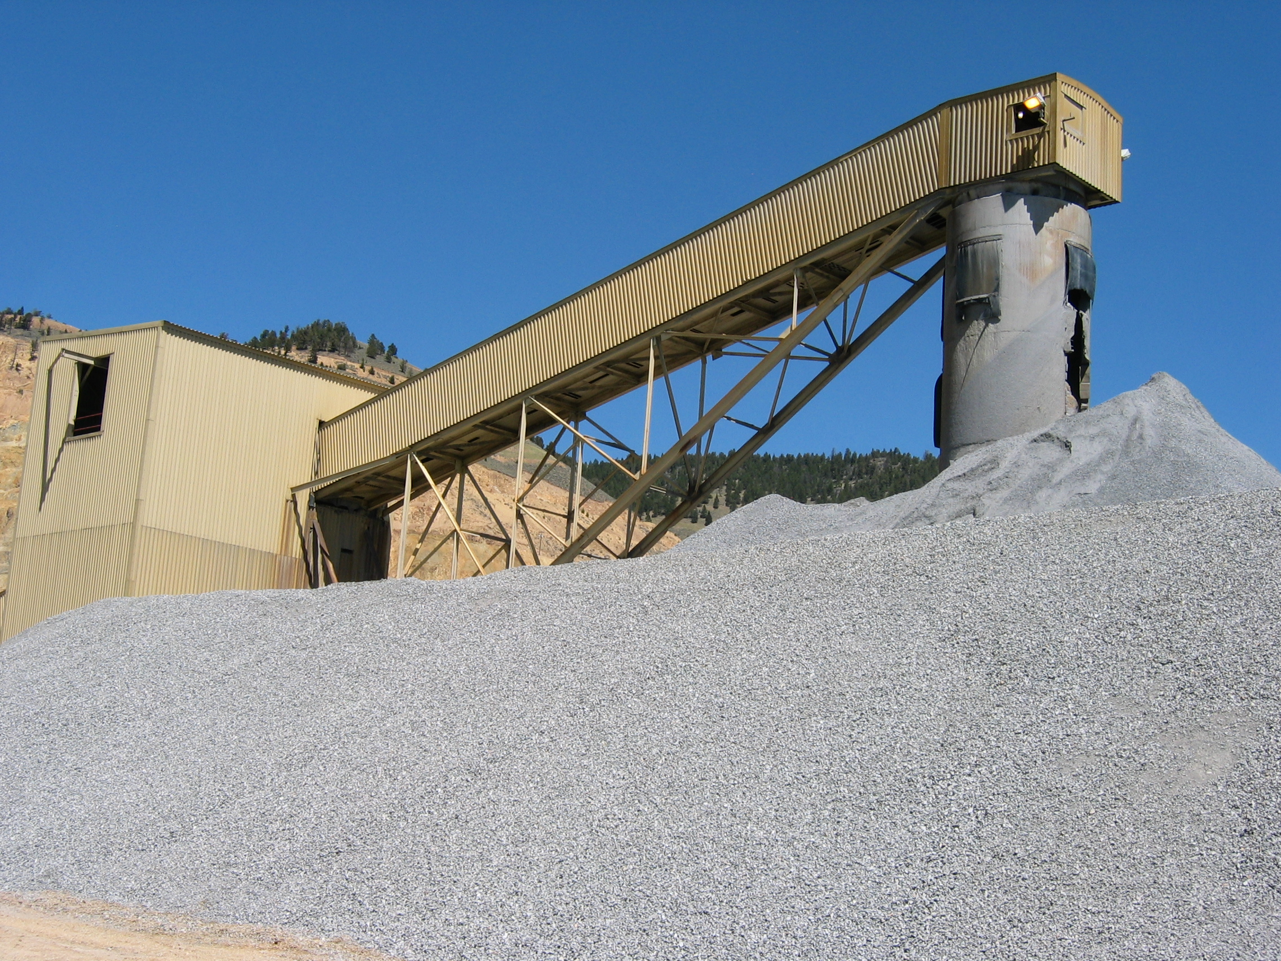
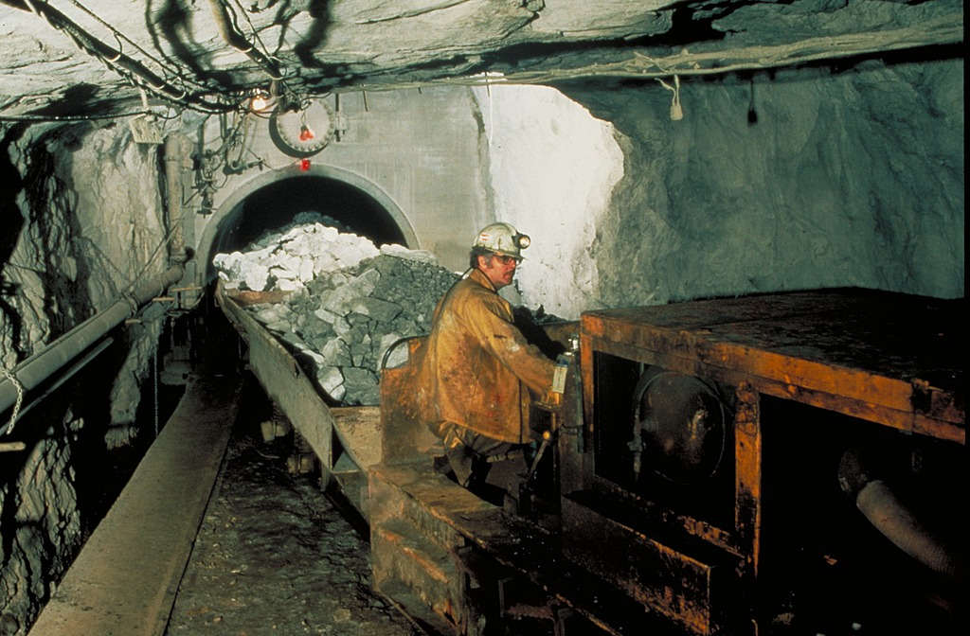
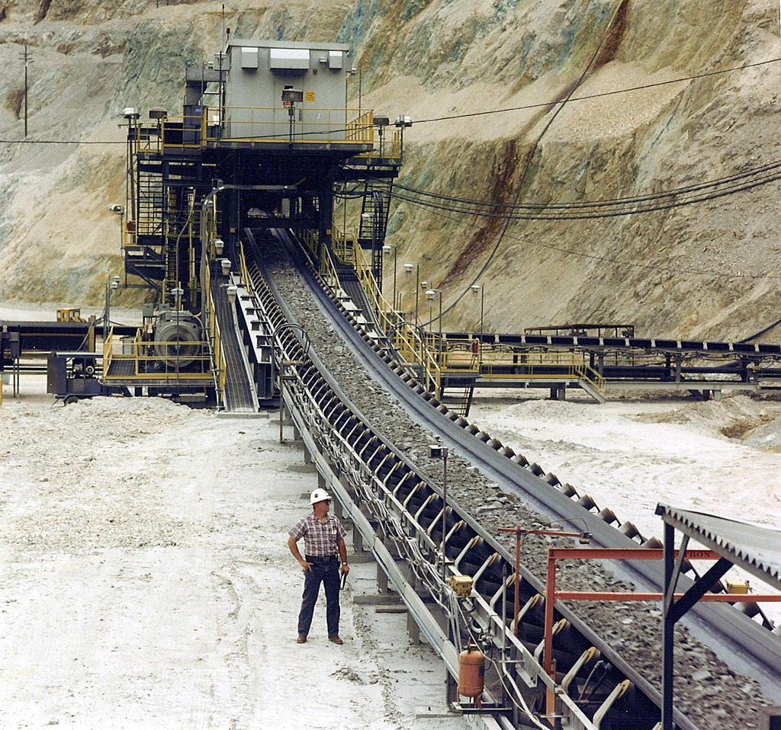
Beneficiation: STEP 1 - Crushing
A conveyor belt (or a truck or a train) brings the ore to the crusher.
Crushed ore ready for the milling process at Golden Sunlight Gold Mine.
A conveyor belt may bring the crushed ore to a mill.
Notes:
Image Information Slide 20 Beneficiation: Crushing:
Conveyor Belt to Crusher: Credit: ASARCO. “Ores are hauled [to the crusher] by rail, truck, or conveyor belt depending on the mine. ” Image courtesy of the Earth Science World Image Bank, http://www.earthscienceworld.org/images. Reproduction under certain conditions is allowed for noncommercial use, http://www.earthscienceworld.org/images/imageuse.html.
Conveyor Belt to Mill: Credit: Travis Hudson, American Geological Institute. “Conveyor taking crushed ore to a mill. ” Image courtesy of the Earth Science World Image Bank, http://www.earthscienceworld.org/images. Reproduction under certain conditions is allowed for noncommercial use, http://www.earthscienceworld.org/images/imageuse.html.

Slide 8
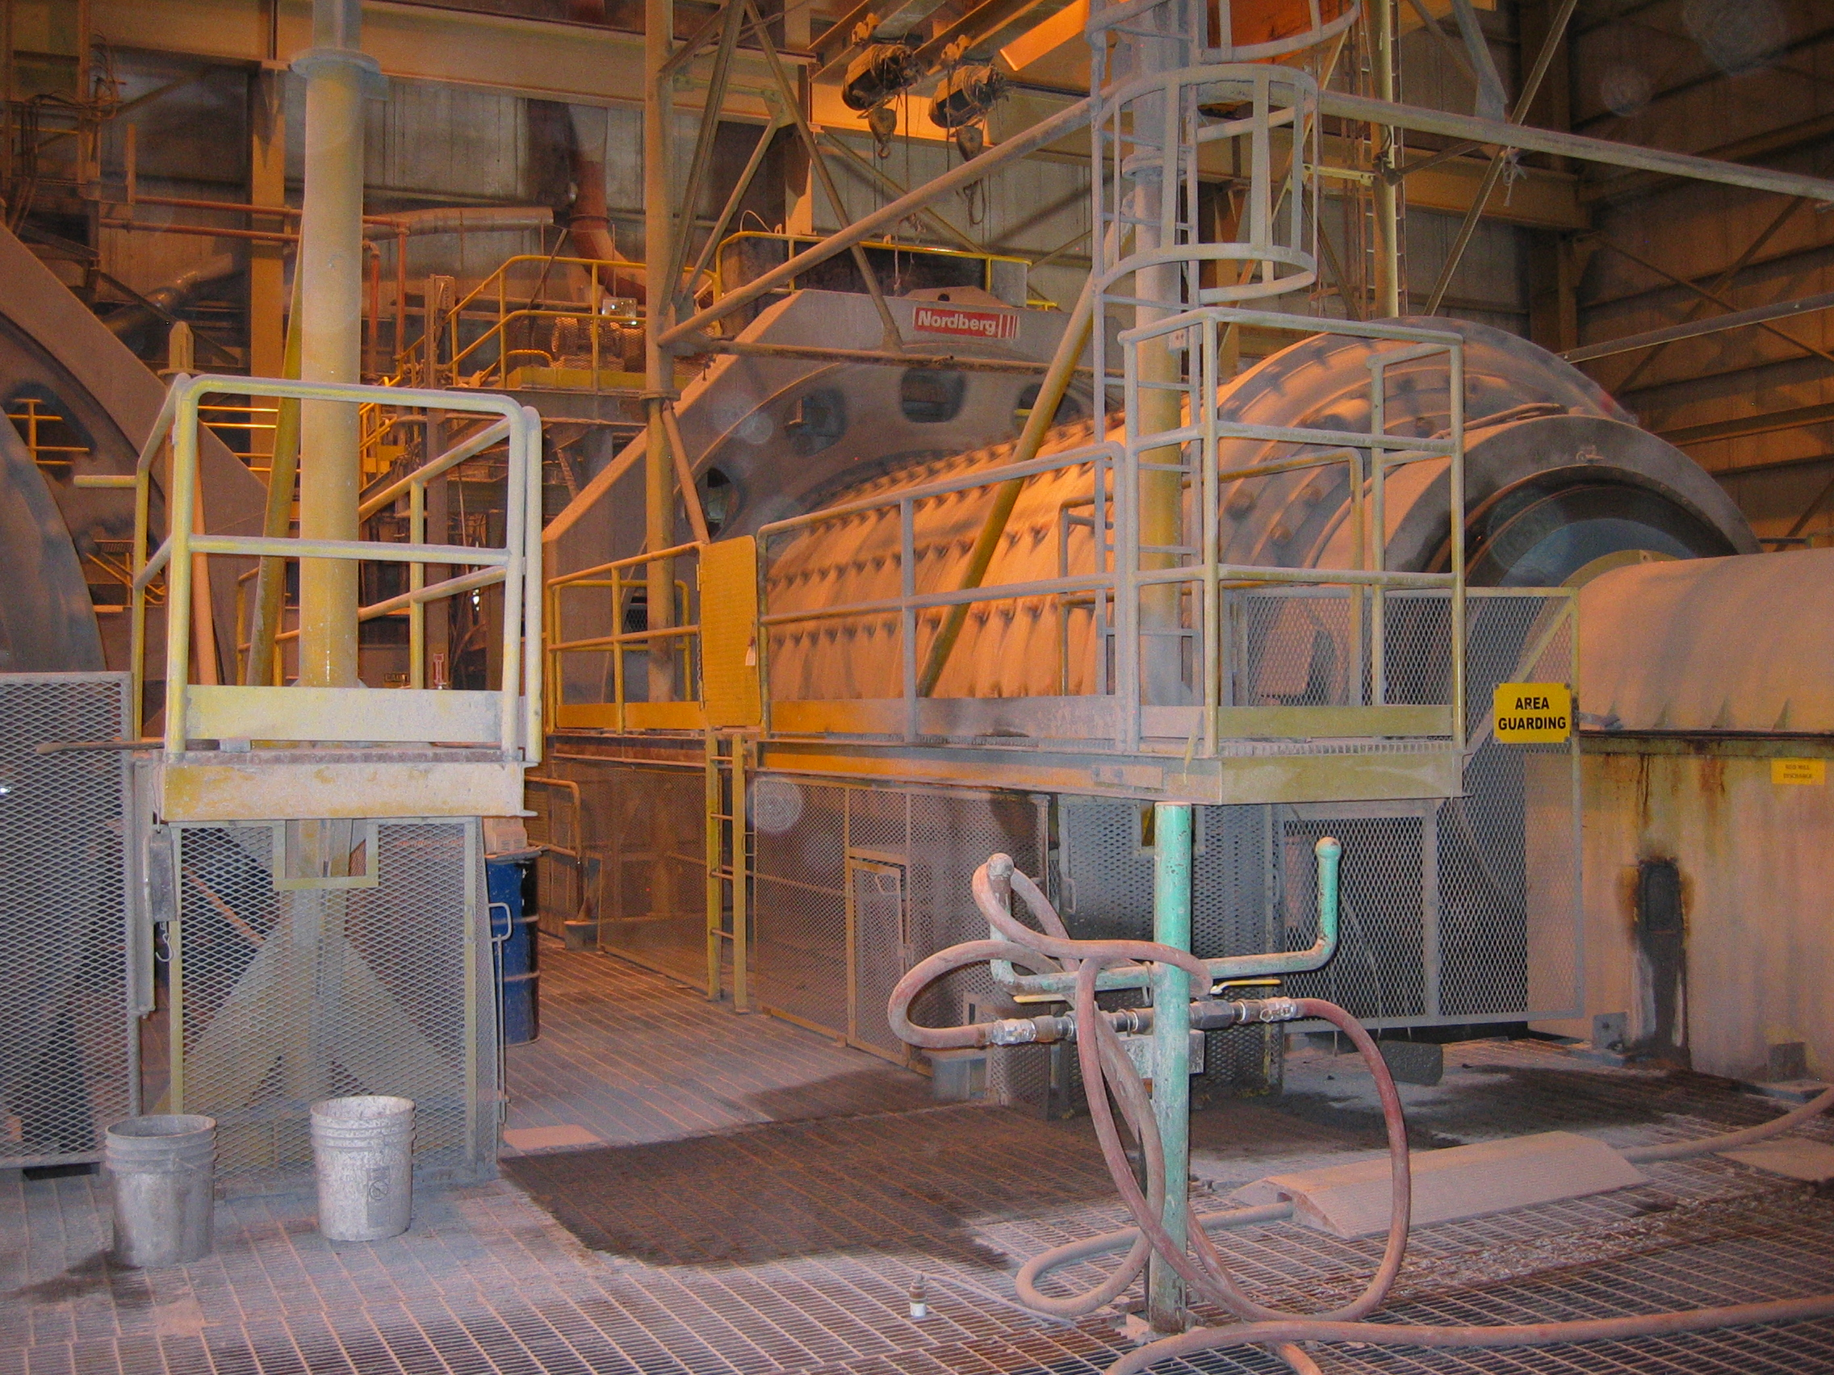
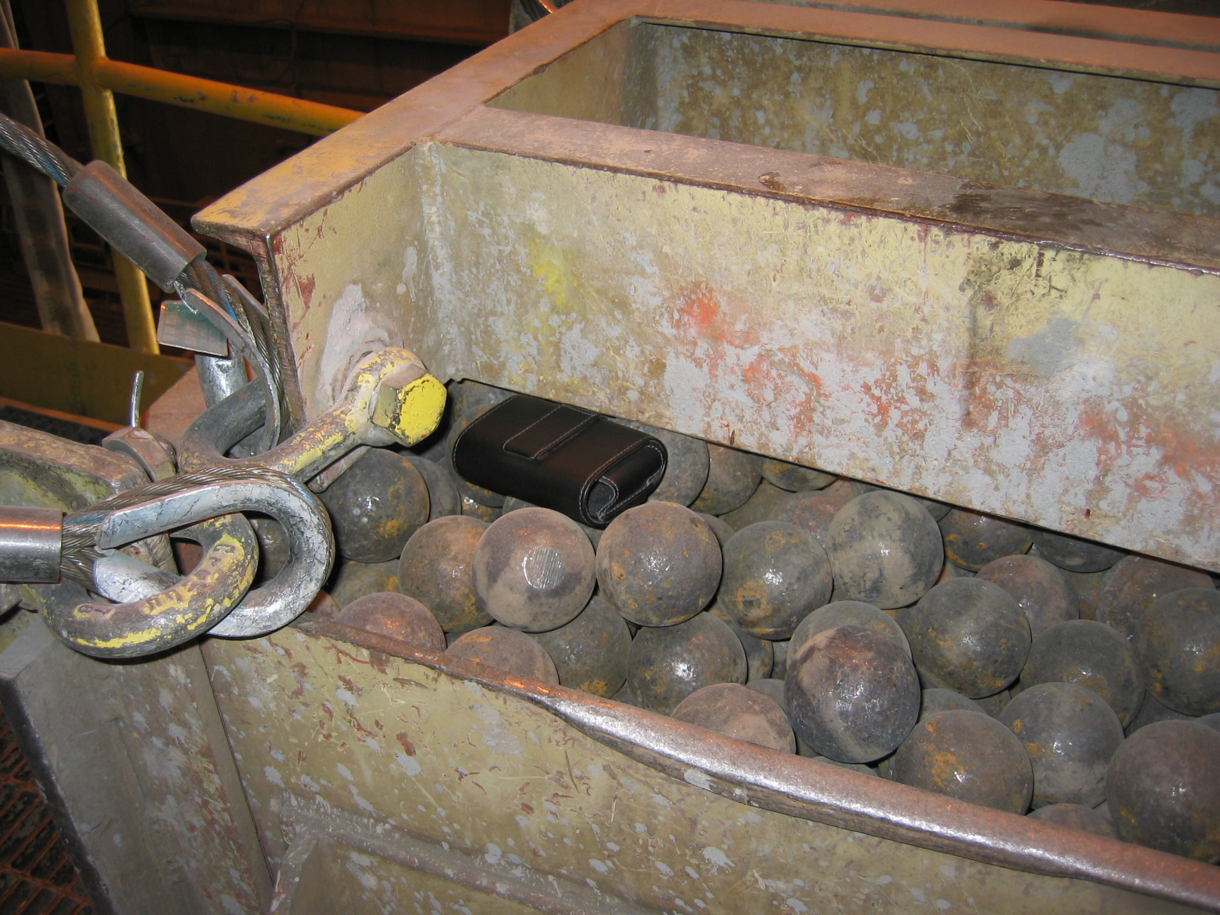
Beneficiation: STEP 2 - Milling
In milling, the crushed ore is placed into a rotating drum with steel rods or balls to break the ore down into a fine-grained powder.
Water is added and the resultant rock slurry moves on to the next step in the process (flotation or leaching).
Rotating drum filled with crushed ore and steel balls
Steel balls help crush ore into individual minerals.
Cell phone case for scale
~5 gallon bucket for scale
Golden Sunlight Gold Mine, MT.
Notes:
Image Information Slide 21: Beneficiation: Milling
Steel balls: Credit: Leah Joseph.
Rotating drum: Credit: Leah Joseph.

Slide 9
Beneficiation: STEP 3 - Flotation
After milling, the ore slurry may be subject to a process called flotation, to further concentrate the mineral
Mix the slurry with a reagent and adds bubbles.
Due to the (specifically selected) chemistry, the desired minerals attach to the bubbles and both will float to the top
Skim off the top
Schematic of one method of flotation. Pine oil is a reagent that can be used for copper beneficiation.
The slurry remaining at the bottom of the tank is considered a waste product (tailings)
Notes:
Image Information Slide 22: Beneficiation: Flotation (I)
Flotation Schematic modified by Leah Joseph from http://www.st-augustines.worcs.sch.uk/intranet/departments/sci2007a/Chemistry/NEWchemstart/metals%20stuff/copper%20stuff/copper%20extr/froth%20float%20diag.gif.

Slide 10
Beneficiation: Flotation – Extra info
One method of flotation using a Jameson Cell is shown in this video and illustrates the general process of flotation: http://www.abc.net.au/catalyst/stories/2533477.htm (~5 min)
A number of other processes may be used to further concentrate the desired mineral. Additional concentration methods may include
using activated carbon
Electroplating
leaching with other reagents such as sodium cyanide

Slide 11
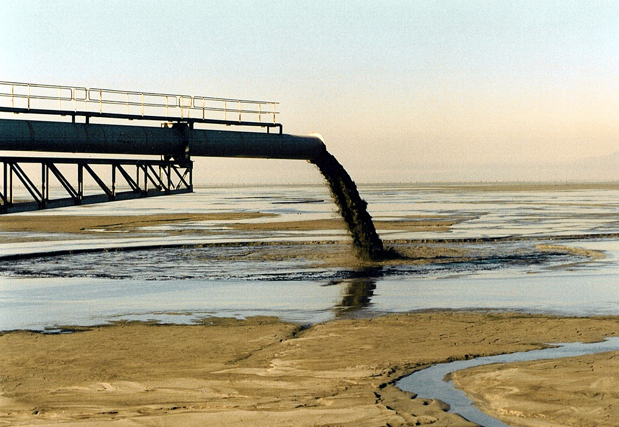
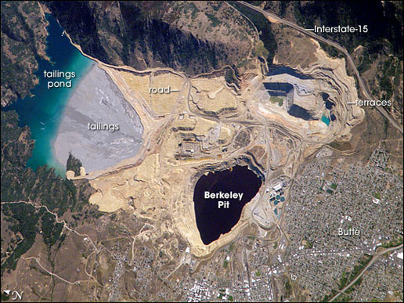
Beneficiation: Tailings
The waste from the flotation process is a tailings slurry.
Pumped into impoundments called tailing ponds
Downhill from the mill (to use gravity to help transport the material).
They can be thousands of acres in extent and a few hundred feet thick.
Satellite image of the Berkeley Pit and mining area with tailings and tailings pond (MT) (2006).
Discharge of tailings slurry into tailings pond.
Notes:
Image Information Slide 24 Beneficiation: Tailings (I):
Tailings Slurry: Credit: Travis Hudson, American Geological Institute. “Slurry of waste minerals (tailings) from the milling process are discarded into nearby impoundments called tailings ponds.” Image courtesy of the Earth Science World Image Bank, http://www.earthscienceworld.org/images. Reproduction under certain conditions is allowed for noncommercial use, http://www.earthscienceworld.org/images/imageuse.html.
Berkeley Pit: Credit: NASA (2006) downloaded from: http://www.nasa.gov/multimedia/imagegallery/image_feature_697.html and is freely available for reuse under these terms: http://www.nasa.gov/audience/formedia/features/MP_Photo_Guidelines.html#.U6MgBxbntvU.

Slide 12
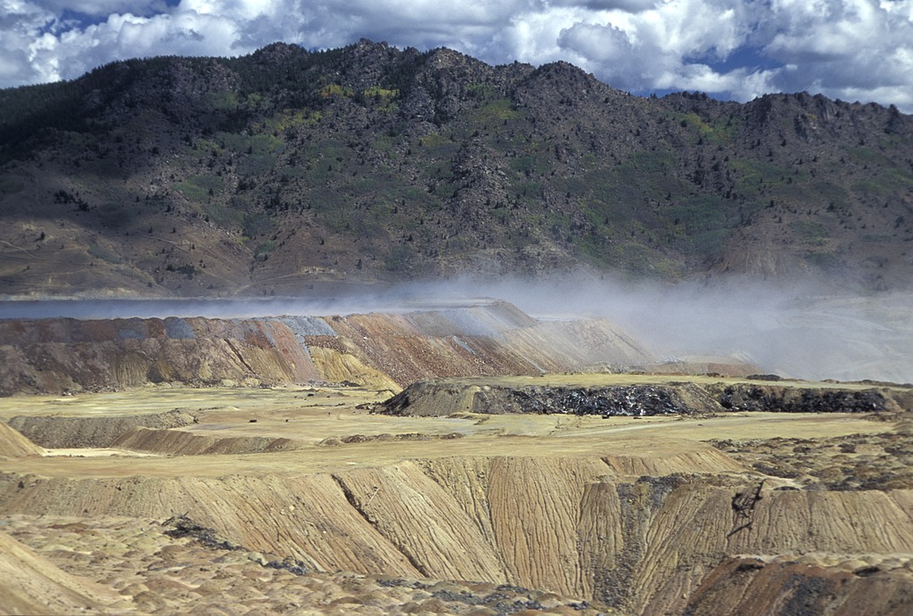
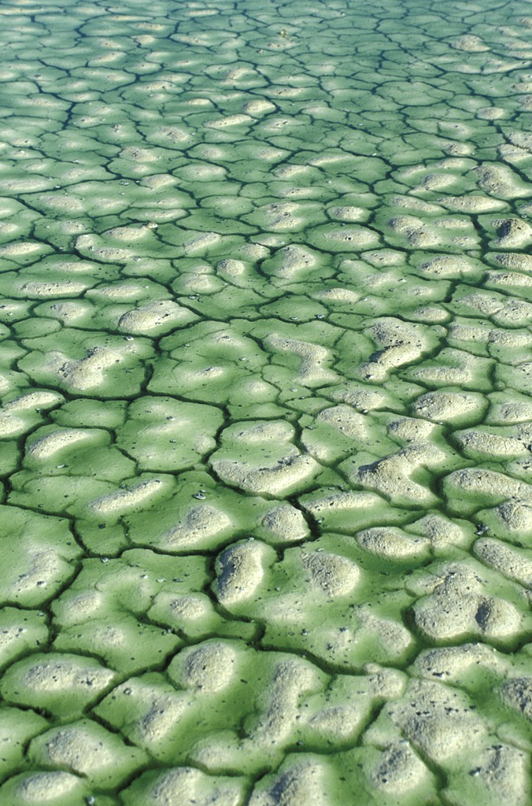
Beneficiation: Tailings
Environmental Problems:
- When sulfide minerals are present in the tailings slurry, these ponds also generate acid mine drainage
- If tailings ponds dry out, metals may be transported in the air and inhaled.
- Accidental catastrophic release of a tailings pond occurs (i.e., dam failure) could release a lot of contamination.
Dried tailings become windblown at the Yankee Doodle tailings pond.
Copper-laden tailings water at the Anaconda Smelter Superfund site, ca. 1992.
Notes:
AMD - influence local soil and water quality and/or increase dissolved metals within the water column.
Image Information Slide 25 Beneficiation: Tailings (II):
Copper Tailing Water: Credit: Stuart Jennings, Montana State University (1992) “Copper-laden water overlying dessicated tailings at the Anaconda Smelter Superfund Site, circa 1992.” Image courtesy of the Earth Science World Image Bank, http://www.earthscienceworld.org/images. Reproduction under certain conditions is allowed for noncommercial use, http://www.earthscienceworld.org/images/imageuse.html.
Dried Tailings: Credit: Stuart Jennings, Montana State University (2000) “Windblown tailings originate from the dried surface of the Yankee Doodle Tailings Pond.” Image courtesy of the Earth Science World Image Bank, http://www.earthscienceworld.org/images. Reproduction under certain conditions is allowed for noncommercial use http://www.earthscienceworld.org/images/imageuse.html.
Plastic Liners: Credit: Stuart Jennings, Montana State University. “Plastic liner in a tailings disposal impoundment”. Image courtesy of the Earth Science World Image Bank http://www.earthscienceworld.org/images. Reproduction under certain conditions is allowed for noncommercial use http://www.earthscienceworld.org/images/imageuse.html.

Slide 13
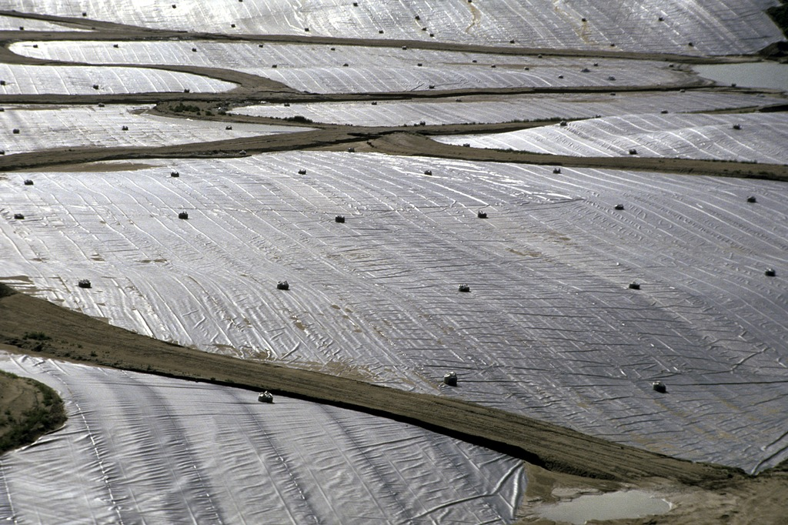
Beneficiation: Tailings
Common Solutions:
- Plastic liners can be put down to prevent drainage of these contaminated waters into the groundwater system
- Water can be treated to neutralize it
- Full tailings ponds are covered with an impermeable liner or soil
Legacy of issues surrounding older (unlined) tailings piles.
Plastic liners put down to prevent tailings water from entering the groundwater.
Notes:
AMD - influence local soil and water quality and/or increase dissolved metals within the water column.
Image Information Slide 25 Beneficiation: Tailings (II):
Copper Tailing Water: Credit: Stuart Jennings, Montana State University (1992) “Copper-laden water overlying dessicated tailings at the Anaconda Smelter Superfund Site, circa 1992.” Image courtesy of the Earth Science World Image Bank, http://www.earthscienceworld.org/images. Reproduction under certain conditions is allowed for noncommercial use, http://www.earthscienceworld.org/images/imageuse.html.
Dried Tailings: Credit: Stuart Jennings, Montana State University (2000) “Windblown tailings originate from the dried surface of the Yankee Doodle Tailings Pond.” Image courtesy of the Earth Science World Image Bank, http://www.earthscienceworld.org/images. Reproduction under certain conditions is allowed for noncommercial use http://www.earthscienceworld.org/images/imageuse.html.
Plastic Liners: Credit: Stuart Jennings, Montana State University. “Plastic liner in a tailings disposal impoundment”. Image courtesy of the Earth Science World Image Bank http://www.earthscienceworld.org/images. Reproduction under certain conditions is allowed for noncommercial use http://www.earthscienceworld.org/images/imageuse.html.

Slide 14
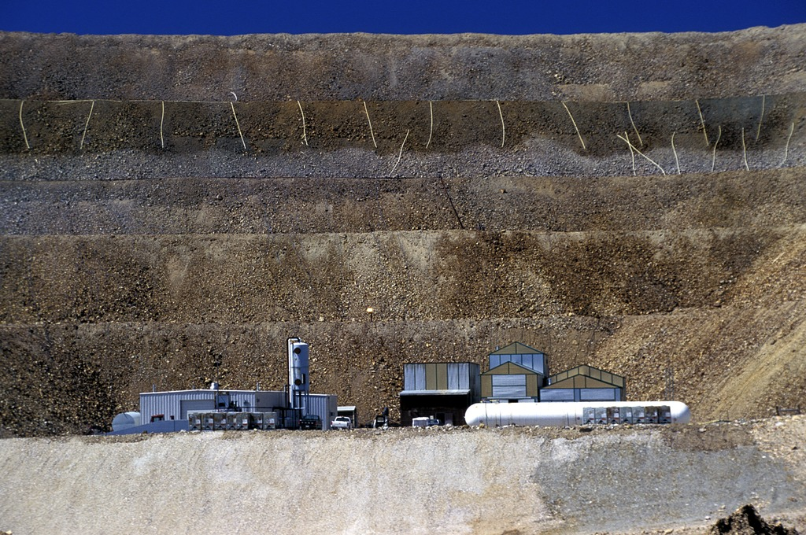
Beneficiation: STEP 4 - Leaching
Leaching (in mining) = use of chemicals (such as sulfuric acid or sodium cyanide) to dissolve and transport metals to a collection area where they are subsequently precipitated back out.
This can take place after milling or instead of milling in large outdoor piles (heaps) or even within the ground itself (in-situ).
The leach piles have many of the same environmental concerns as tailing ponds (with additional nasty chemicals added)
Heap leaching - sodium cyanide will percolate down through these pile and be collected at the bottom
Heap leaching at the Zortman-Landusky Mine (ca. 1996).
Notes:
Image Information Slide 26 Beneficiation: Leaching:
Leach Pile: Credit: Stuart Jennings, Montana State University (1996) “Sodium cyanide heap leaching and metal recovery operations at the Zortman-Landusky Mine.” Image courtesy of the Earth Science World Image Bank, http://www.earthscienceworld.org/images. Reproduction under certain conditions is allowed for noncommercial use, http://www.earthscienceworld.org/images/imageuse.html.

Slide 15
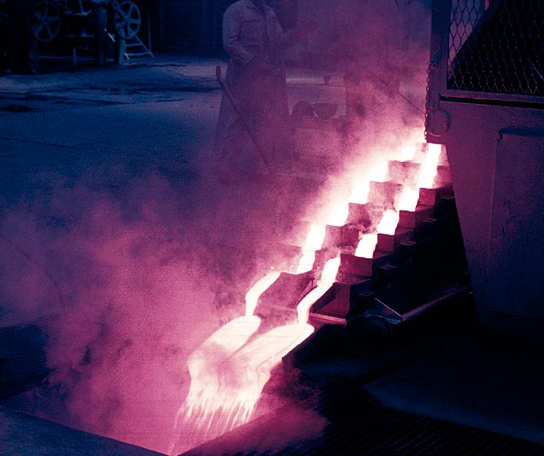
Next - Smelting
Smelting separates the metal from the mineral by melting it in the presence of a material known as a flux.
The desired mineral settles to the bottom of the melt and can be separated out.
The undesirable waste material is called slag.
The smelter may be off-site from the mine.
Smelting gold.
Notes:
Image Information Slide 27 Smelting:
Smelting Gold: Credit: A.J. Mandolesi, American Geological Institute. “Refining gold.” Image courtesy of the Earth Science World Image Bank, http://www.earthscienceworld.org/images. Reproduction under certain conditions is allowed for noncommercial use, http://www.earthscienceworld.org/images/imageuse.html.

Slide 16
Next - Smelting
Environmental Impacts
Emissions from smelting may include:
Sulfur dioxide
Lead
Particulates
Other gases
Increased regulation and improved
technologies in the U.S. have resulted
in a reduction in the amounts and
types of dangerous emissions
Smelting gold.
Notes:
Image Information Slide 27 Smelting:
Smelting Gold: Credit: A.J. Mandolesi, American Geological Institute. “Refining gold.” Image courtesy of the Earth Science World Image Bank, http://www.earthscienceworld.org/images. Reproduction under certain conditions is allowed for noncommercial use, http://www.earthscienceworld.org/images/imageuse.html.

Slide 17
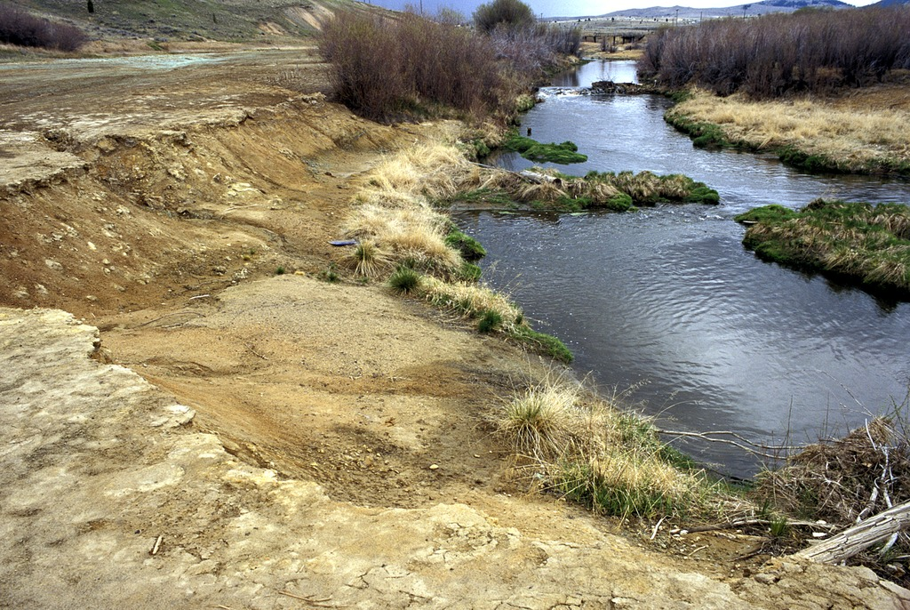
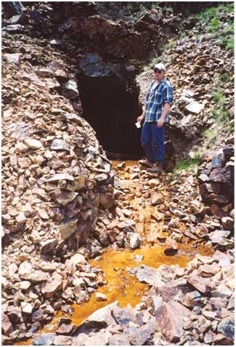
Mine Closure
Eventually, the mine will close when the recoverable ore runs out
→ The U.S. has many mines that closed prior to the recent regulations
→ Tons of environmental problems have resulted…
There are 55,000 abandoned hardrock mines in the West on public lands alone that will cost ~50 billion dollars to clean up
Acidic mine tailings on the floodplain of Silverbow Creek in MT before remediation ~1998.
Notes:
Image Information Slide 28 Mine Closure:
Acid Mine Tailings: Credit: Stuart Jennings, Montana State University (1998) “Acidic mine tailings cover the floodplain of Silverbow Creek, near Butte, Montana, prior to remediation work (image 1998).” Image courtesy of the Earth Science World Image Bank http://www.earthscienceworld.org/images. Reproduction under certain conditions is allowed for non-commercial use (http://www.earthscienceworld.org/images/imageuse.html).

Slide 18
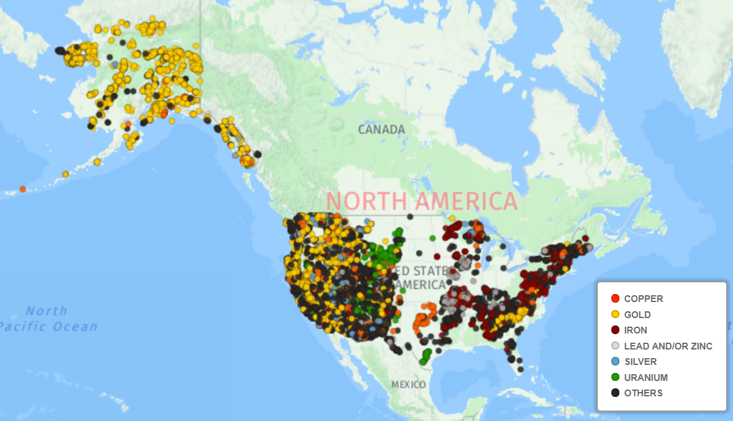

Slide 19
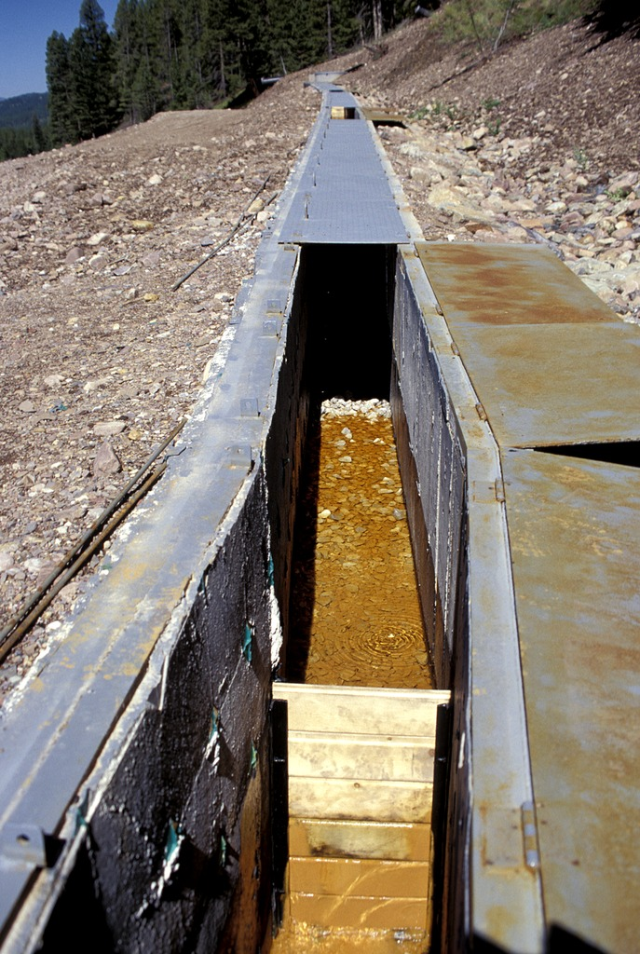
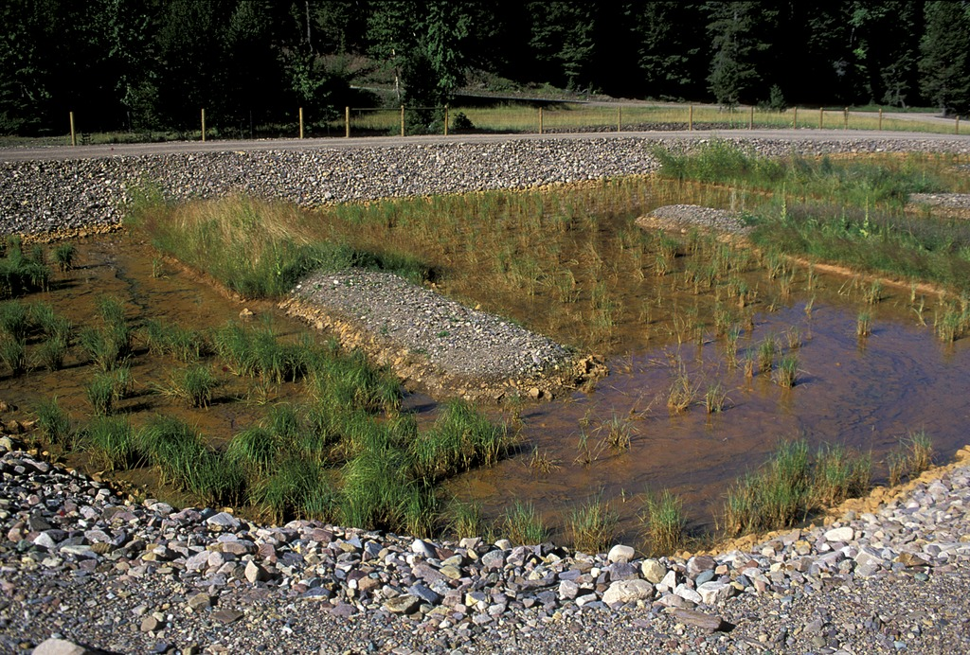
Remediation
Remediation is the process of fixing, removing, or counteracting an environmental problem.
Like reclamation, treatment of contaminated water does not need to wait until the mine closes - should be done as mining happens.
One method of treating acidic mine water is to add alkaline material
raises the pH
causes metals to precipitate
Acidic mine water flows along a channel containing limestone, to increase the pH (lower the acidity). Anaconda Mine, ca. 1997.
Continued treatment in a wetland, where the plants help remediate the water. Anaconda Mine, ca. 1997.
Notes:
Image Information Slide 30 Remediation:
Adding Alkaline Material: Credit: Stuart Jennings, Montana State University. “Mike Horse Mine pretreatment pond with alkaline addition, precipitation of iron and other metals.” Image courtesy of the Earth Science World Image Bank, http://www.earthscienceworld.org/images. Reproduction under certain conditions is allowed for noncommercial use http://www.earthscienceworld.org/images/imageuse.html.
Limestone Channel at Anaconda Mine: Credit: Stuart Jennings, Montana State University (1997) “An open limestone channel treats acidic discharge from the Anaconda Mine shaft prior to wetland treatment.” Image courtesy of the Earth Science World Image Bank, http://www.earthscienceworld.org/images. Reproduction under certain conditions is allowed for noncommercial use http://www.earthscienceworld.org/images/imageuse.html.
Wetland Treatment: Credit: Stuart Jennings, Montana State University (1997) “Mine water treatment wetland showing removal of iron contamination from Anaconda Mine.” Image courtesy of the Earth Science World Image Bank, http://www.earthscienceworld.org/images. Reproduction under certain conditions is allowed for noncommercial use http://www.earthscienceworld.org/images/imageuse.html.

Slide 20
Mines today
Mines today in the U.S. must meet different standards than in the past
Must plan for environmental and human health protection both while they are in operation and after mine closes.
This planning includes stabilizing slopes to decrease erosion and treating the soil and water so that contamination is either contained or removed.
Many companies have taken all the minerals and then declared bankruptcy
In 1992, the law was amended to require mining companies to post 100% of the cleanup costs upfront in case they go bankrupt

Slide 21
Mineral Extraction Concerns
Notes:
Every step of the mineral extraction process is more complex than described here.
The mining industry provides jobs (directly and indirectly tied to the mine), allows creation of products, pushes technology forward, and plays a key role in local and global economic systems.
While regulations in the United States have become much more stringent since the 1970s, there are still environmental and health issues that the mineral extraction process incurs, and how to safely close a mine may not be clear.

Slide 22
Mineral Extraction Concerns
The use of water, especially in arid regions.
Contamination of water through AMD, accidental spills, or other.
Mines that are not meeting federal or state regulations.
The impact on forests, including habitat destruction or alteration.
The use of public lands, such as in National Forests, for mineral extraction.
Worker health and safety, although this has been much improved since the 1980s (and earlier) labor laws.
Ground subsidence above underground mines.
Notes:
In addition to dealing with the legacy left by historical mining due to acid mine drainage and other contamination problems, some other issues related to mining include:
Image Information Slide 32 Additional Mineral Extraction Concerns:
Land Collapse: Credit: Rolinator (2006) Collapse of Elura Underground Mine (Australia). Downloaded from http://upload.wikimedia.org/wikipedia/commons/2/2d/Elura.png under a public domain license (http://en.wikipedia.org/wiki/File:Elura.png).

Slide 23
Reality of Mineral Use
Bottom Line: Are we paying the true cost of mineral resources?
What about minerals taken from government land at little cost with environmental degradation at every step?

Slide 24
In the US,
Mining companies get:
depletion allowances – so they pay less taxes
use government land and pay no royalties
Justification - mineral prospecting is expensive and mineral development is very expensive and risky

Slide 25
General Mining Law of 1872
Governs mining on federal lands
Concerns only hardrock minerals – ie, gold silver, iron, copper, lead, etc. – not coal
Just need to spend $500/yr to keep claim valid
Don’t pay royalties to the government for minerals they take off these lands
Any of you can stake a mining claim on federal lands!

